Slide 1
Improving the throughput of veterinary drug residue analysis using vibrational shaking technology
Dr Martin Danaher
Food Safety Department,
Teagasc Food Research Centre, Ashtown, Dublin, Ireland.

Slide 2
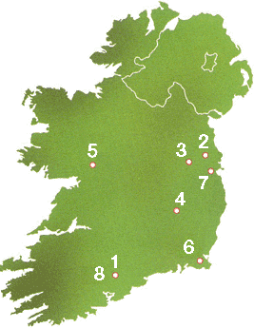
Teagasc (chaw-gask) Research
- 300 research projects
500 scientific and technical staff and ~ 100 postgraduate research
students (MSc, PhD) in collaboration with Irish universities
8 Research centers across the country
Agriculture
1. Dairy & pig production
3. Beef production
4. Crops
Sheep production
Environment
Food
7. Ashtown, Dublin
8. Moorepark, Cork

Slide 3
Why Monitor for residues in food?
Exposure to high concentrations of veterinary drug residues through food consumption can potentially impact on human health, especially vulnerable individuals
Neonates
Pregnant women
Other sensitive groups
Examples of undesirable toxic effects
Teratogenic/Embryotoxic - Anthelmintics
Neurotoxic – Ivermectin/Pyrethroids
Allergic reaction - Penicillins

Slide 4
Economics
Agri-food is Irelands largest indigenous industry
Employs 150,000 people
Annual value of €24 billion
Beef and livestock sector (€1.9 billion)
Ireland is the second largest producer and exporter of infant milk formula
Brand Reputation: Food island “green” image
Compliance with EU Legislation

Slide 5
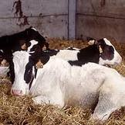
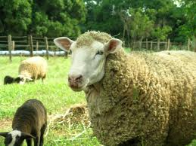
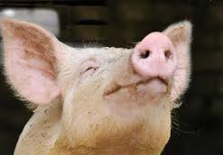
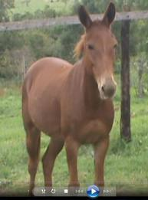
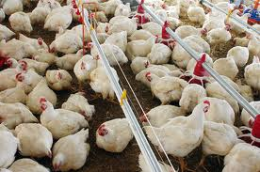
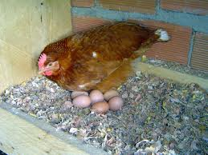
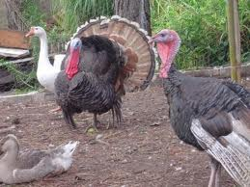
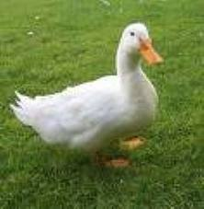
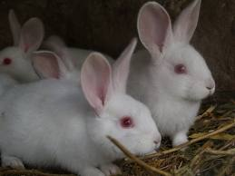
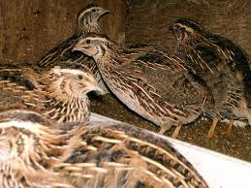
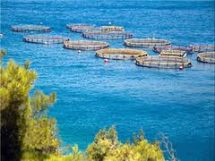
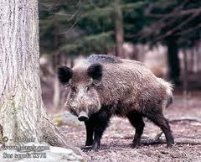
Food producing species

Slide 6
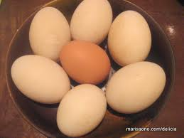
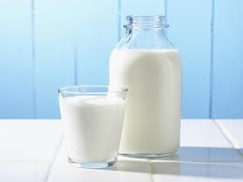
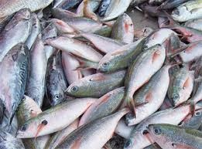
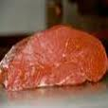
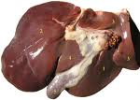
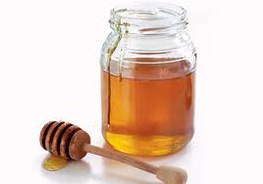
Analytical matrices

Slide 7
Bioanalytical methods

Slide 8
Trends in Residue Analysis
Pre-2008 lower throughput 24 samples per day.
Post-2008 methods implemented 50 samples per day
Move from HPLC-UV/FLD or GC-ECD to LC-MS/MS or GC-MS(/MS)
Development of high throughput generic sample preparation methods e.g. QuEChERS.
Since, exponential improvement in MS technology, allowing analytical separation to be compressed.
Desirable to improve the detection of non-compliant results by analysing more samples but this is limited by challenges in sample preparation.

Slide 9
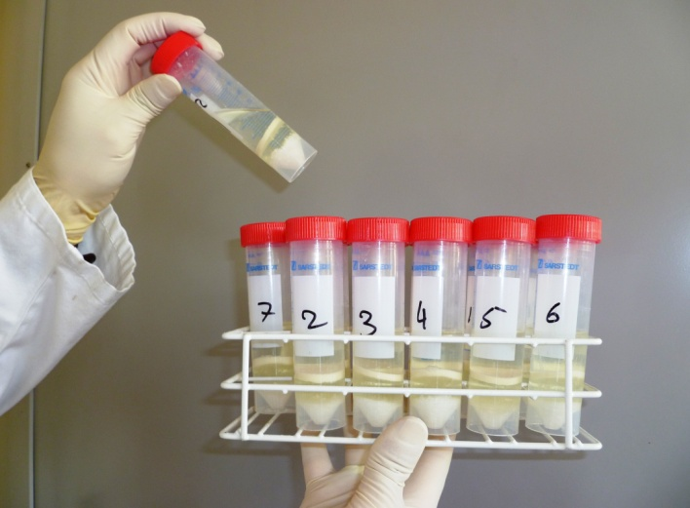
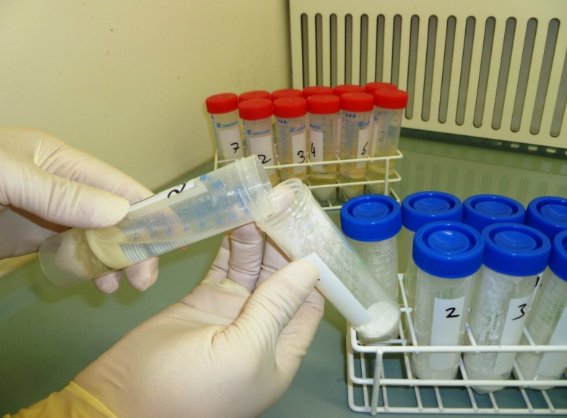
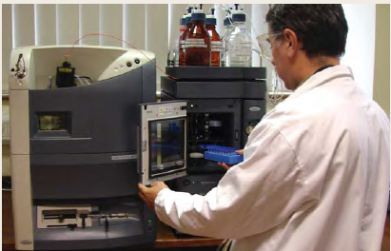
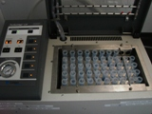
QuEChERS Approach
4g MgSO₄ + 1g NaCl
1.5g MgSO₄ +
0.5g C₁₈
Phase Separation
D-SPE
6 mL Supernatant +
0.5 mL DMSO
Analysis
Concentration

Slide 10
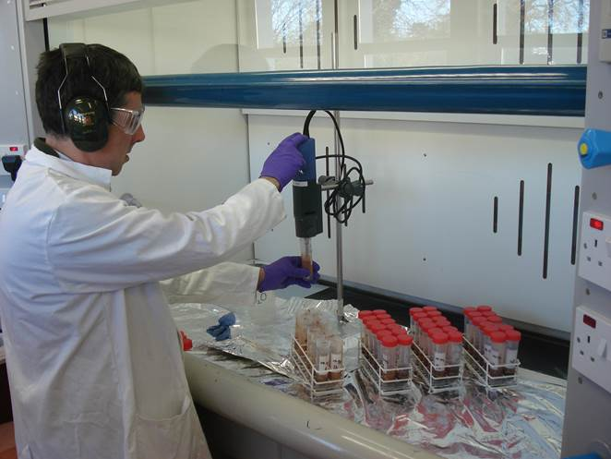
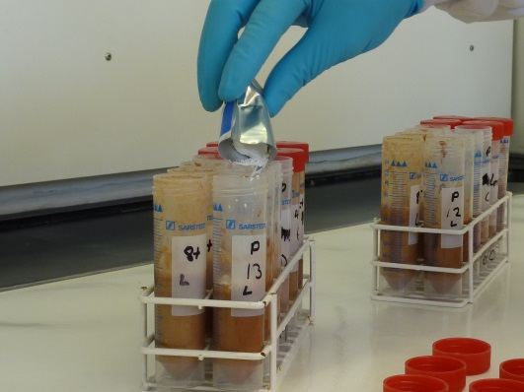
QuEChERS Extraction
Probe homogenisation (30 sec).
Clean probe (60 sec).
Total time = 54 min (for 36 samples).
Add salts.
Shake samples (60 sec).
Total time = 6 min.

Slide 11
Limitations of QuEChERS
Six samples can be only shaken at a time:
Otherwise you can get clumping of salts and poor dispersion of the sample.
Insufficient shaking of samples can lead to lower extraction efficiency and inconsistent results.
The samples need to be blended or prehomogenised.

Slide 12
Probe based extraction
Disperses sample and increases contact with solvent.
30-60 sec 18000 rpm.
Effective and efficient
Low throughput, one sample at a time.
Requires cleaning of probe between samples.
Ice bath required for volatile or thermally labile analytes.

Slide 13
Ceramic Homogenisers
Reported application in QuEChERS by Rothermich, Agilent Technologies at EPRW 2010.
Reduces shaking time from 60 sec to 20 sec.
Breaks up MgSO₄ and NaCl clumps during QuEChERS extraction of veterinary drug residues from animal tissue.
Improved and more consistent recovery.

Slide 14
Automated shaking
Ceramic homogeniser pellets are added to samples.
Salts are added to samples at same time.
Samples (n = 36) are placed in the shaker in the test tube racks (n = 3).
Rack is clamped.
Samples are shaken at 700 rpm.
Instrument shaking time is adjusted to give the desired extraction efficiency.

Slide 15
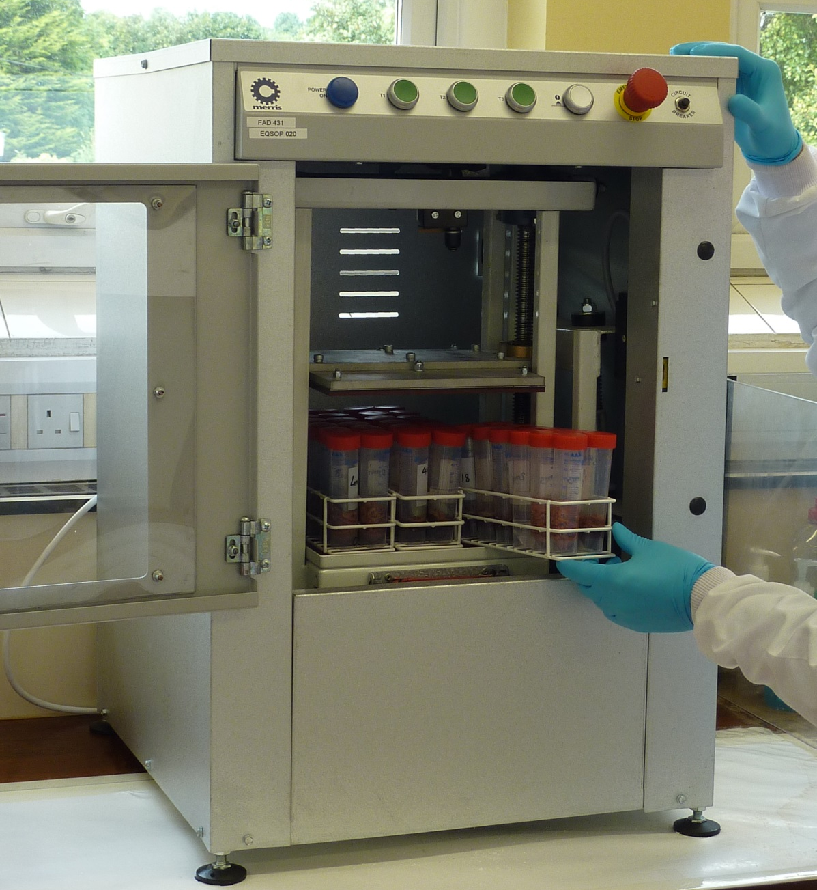
Vibrational Extraction System
Emergency stop
Operating light
Shaking speeds
Start/Stop button
Clamp
Electronic door locking

Slide 16
Research questions
How does this extraction approach compare to the standard probe based extraction?
How does it work with naturally incurred samples?
Will the approach reduce sample preparation time in the laboratory?
Notes:
For this I would show four rack for muscle and liver both with and without.

Slide 17
Experimental Results

Slide 18
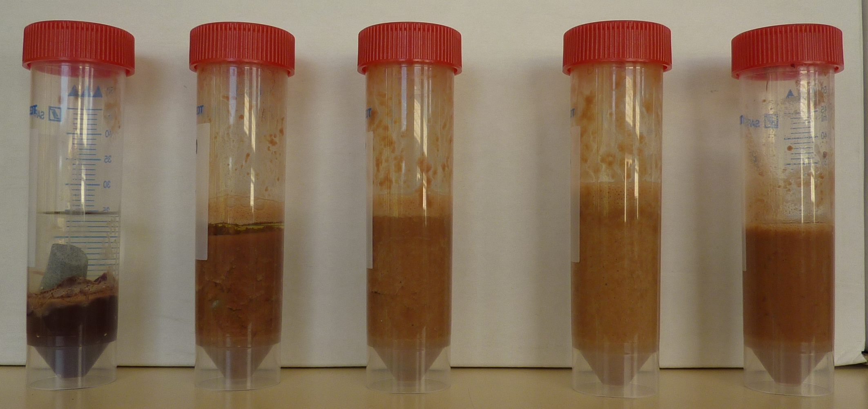
Shaker vs Probe (Liver tissue)
0 min
2 min
4 min
8 min
Probe
30 sec
10 g bovine liver samples extracted with 12 mL ACN

Slide 19
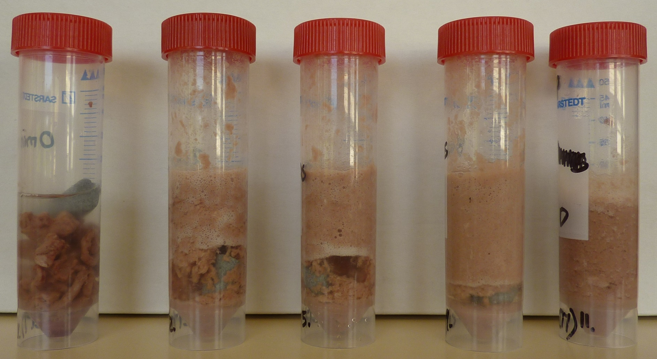
Shaker vs Probe (Muscle tissue)
Probe
30 sec
0 min
2 min
4 min
8 min
10 g sample extracted with 12 mL ACN

Slide 20
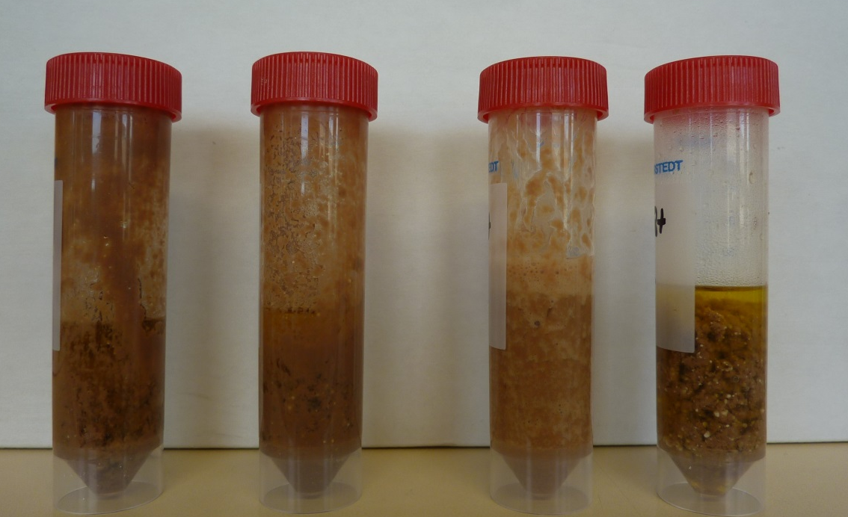
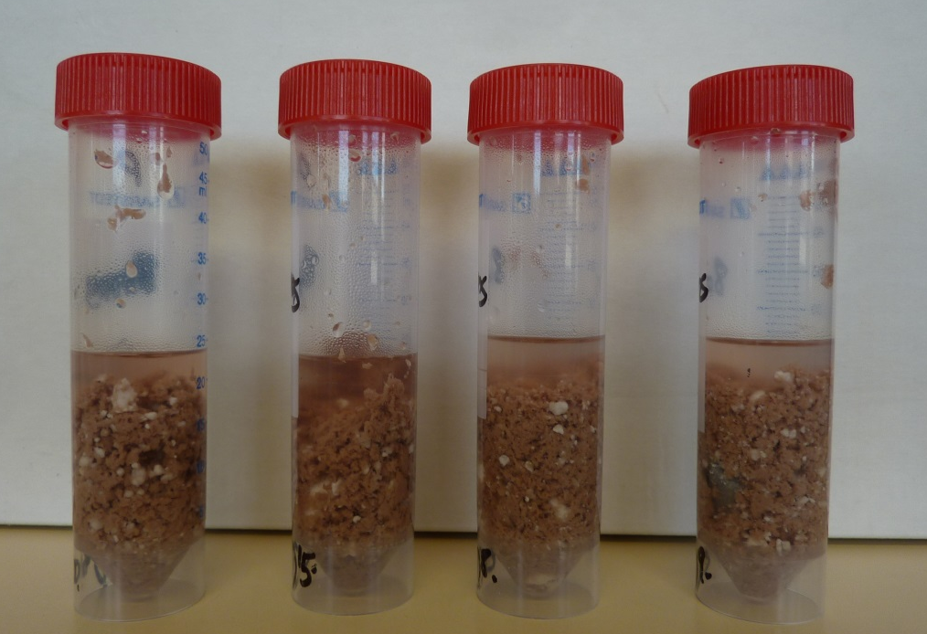
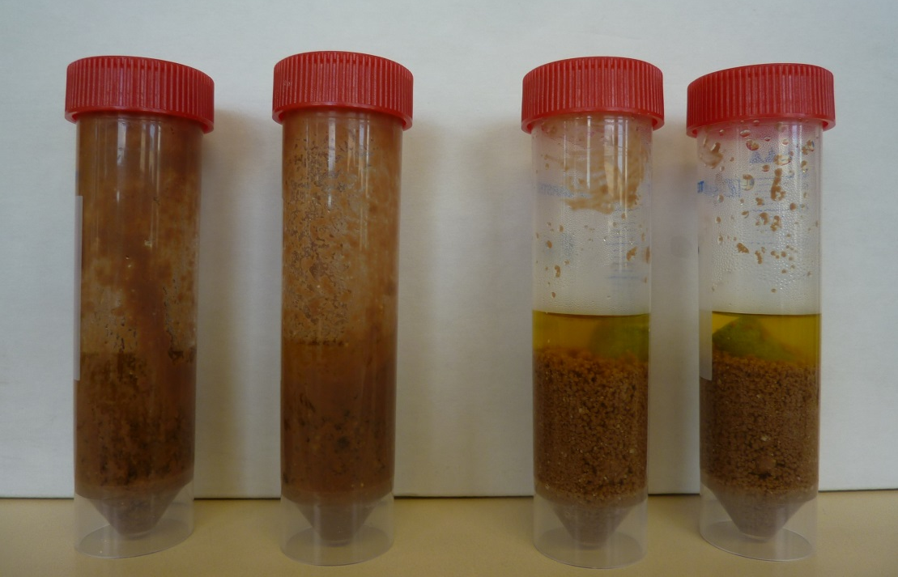
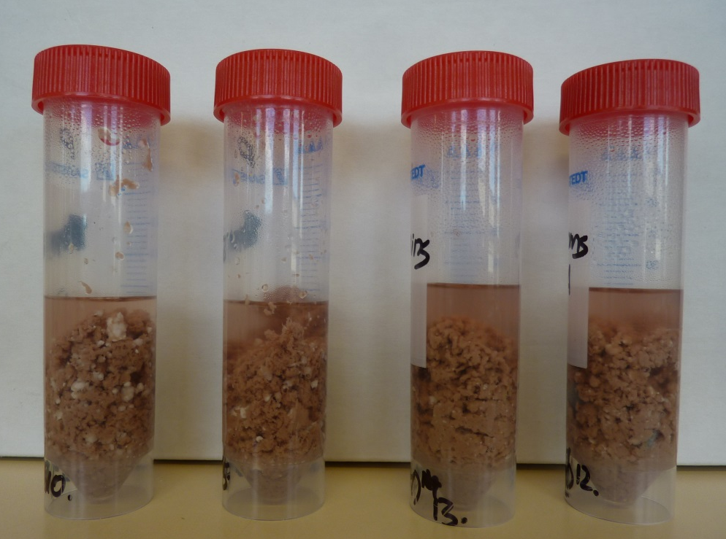
QuEChERS Extraction
Liver Samples (manual)
Muscle Samples (manual)
P
P
C
C
P
P
C
C
Liver Samples (Shaker)
Muscle Samples (shaker)
P
P
C
C
P
P
C
C

Slide 21
Standard vs New Method
Liver
Liver
Muscle
Muscle
P
C
P
C

Slide 22
Incurred bovine liver study

Slide 23
Incurred bovine muscle study

Slide 24
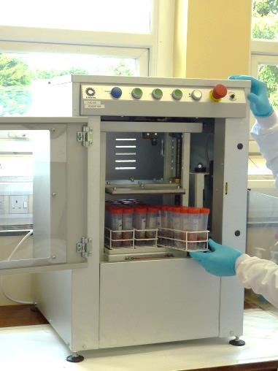
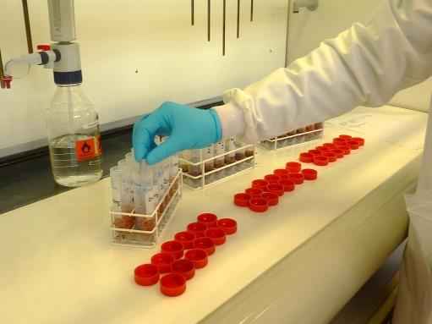
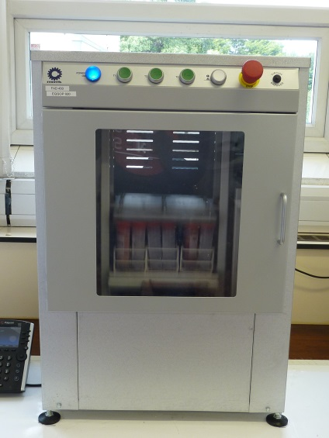
QuEChERS Extraction
8 min
Comparison
Probe method >60 min.
Shaker 13 min.
Time saving of 47 min for 36 samples
5 min

Slide 25
Anticcoccidials in meat

Slide 26
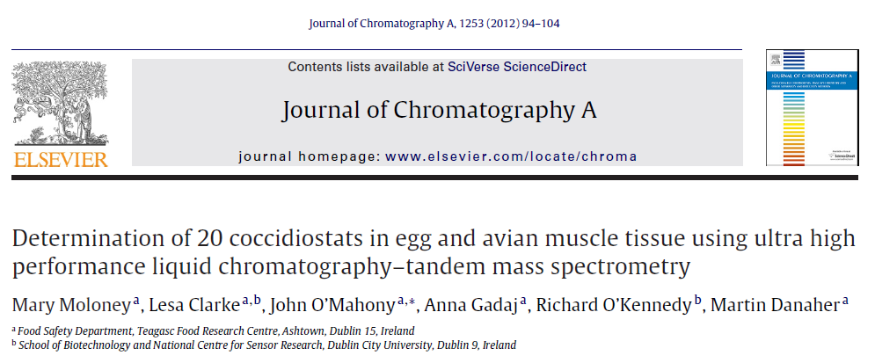
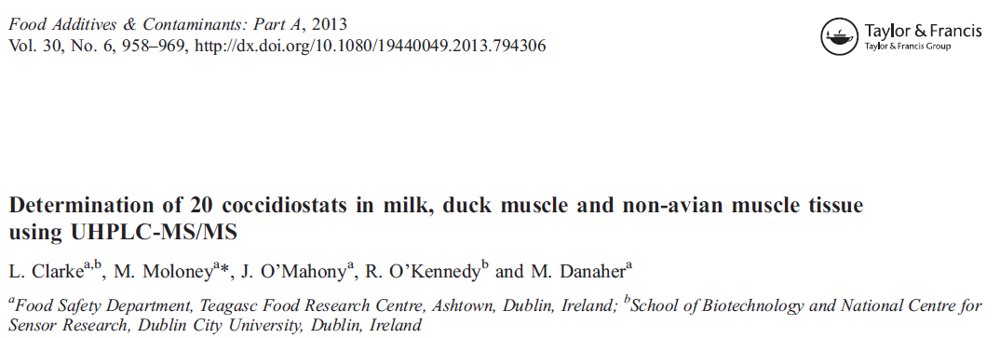

Slide 27
HILIC Separation
LC-MS/MS Set-Up B
Kinetex 2.6 μm Hilic100A 100 x 2.1 mm
MPA: 50mM Ammonium Formate + 0.1% Formic
MPB: MeCN + 0.1% Formic
Column Temp: 50 C
Injection Volume: 2.5 μL
Hilic Gradient
TIME (MIN) | %A | %B
Initial | 5 | 95
1.50 | 5 | 95
2.00 | 50 | 50
3.10 | 50 | 50
3.20 | 5 | 95
4.50 | 5 | 95

Slide 28
RP-UHPLC Separation
C8 Gradient
LC-MS/MS Set-up A
Acquity UPLC BEH C8 1.7µm, 2.1x50 mm Column
MPA: H₂O +0.1% Formic
MPB: MeCN + 0.1% Formic
Flow Rate: 0.6 mLmin⁻¹
Column Temp: 60 C
Injection Volume: 2.5 µL
TIME (MIN) | %A | %B
Initial | 100 | 0
2.00 | 100 | 0
2.10 | 83.3 | 16.7
3.50 | 83.3 | 16.7
3.90 | 55.5 | 44.5
5.00 | 55.5 | 44.5
5.50 | 33.5 | 66.5
9.00 | 33.5 | 66.5
9.10 | 0.0 | 100
11.10 | 0.0 | 100
11.20 | 100 | 0
13.20 | 100 | 0

Slide 29
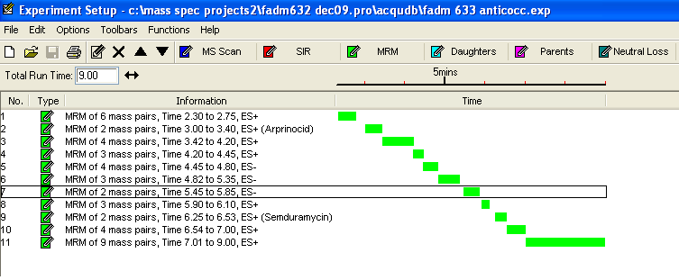
MS/MS overview
C8 acquisition
HILIC acquisition

Slide 30
Sample preparation overview
Weigh 5g meat
Weigh 5g meat
Add 20 mL of MeCN (Pest)
Add 20 mL of MeCN (Pest)
Homogenise, 1 min; Vortex 1 min
Shake, 20 min @ 200 rpm
Centrifuge, 10 min, 3500 rpm, 4 C
Vibrational shaker 8 min.
Centrifuge, 10 min, 3500 rpm, 4 C
N2-Evap. 10 mL
N2-Evap. 10 mL
Reconstitute, 80:20 v/v MeCN:H₂O
Filter, 0.2 μm PTFE
Reconstitute, 80:20 v/v MeCN:H₂O
Filter, 0.2 μm PTFE
LC-MS/MS Analysis
LC-MS/MS Analysis

Slide 31
Fortified chicken muscle study

Slide 32
Anticoccidials result summary
Results summary overall
Precision | Probe | Shaker (5 min) | Shaker (8 min)
<10% | 15 | 16 | 14
10-23% | 7 | 7 | 7
>23% | 1 (lasalocid) | 1 (Amprol.) | 2 (Amprol. & Lasal.)
Higher response with shaker for amprolium, decoquinate and semduramicin,
 | Recovery (%)
Analyte | Shaker (5 min) | Shaker (8 min)
Amprolium | 131 | 183
Decoquinate | 118 | 149
Semduramicin | 109 | 136
Notes:
For this I would show four rack for muscle and liver both with and without.

Slide 33
Conclusions
Vibrational shaking in combination with ceramic homogenisers gives comparable disruption to probe homogenisation.
Results with incurred tissue is comparable for the analytes tested, better in some cases.
Because disruption is carried out in a closed tube the risk of cross-contamination of samples during sample preparation is low.
The approach significantly improves sample throughput in the laboratory.
Possible to achieve more output with the same resources.
Notes:
For this I would show four rack for muscle and liver both with and without.

Slide 34
Acknowledgements
Teagasc Walsh Fellowship programme for funding this research.
Teagasc Staff for conducting experiments, processing data and help in preparing this presentation.
Acknowledge in particular: Sarah Tuck, Damien Mooney, Cormac McElhinney, Conor Lavelle and Mary Moloney.

